Slide 1
Playwright Training
Control Statements

Slide 2
The Golden Circle
What
What is Control statement?
The statements that define the flow of the program
Why
Why is Control Statement required?
Provide a logic based flow like chrome based vs firefox based execution
How to implement Control Statements?
How
Using Selection, Iteration and Jump Statements

Slide 3
Control Statements
Keywords & Lower case
Control
Selection
Iteration
Jump
if .. else
switch .. case
break
continue
for
for .. each
while
do while

Slide 4
Selection Statements : When to use what?
Keywords & Lower case
Control
Selection
Type | When
if . else | When you have few conditions
switch . case | When you have multiple conditions
if .. else
switch .. case

Slide 5
Selection Statements : Examples
Keywords & Lower case
Control
Selection
Type | Example
if . else | Report pass or fail
switch . case | Launch based on browser types
if .. else
switch .. case

Slide 6
if syntax
if Statement (Single Condition)
The if statement executes code only if the condition is true.
Example: Check if a number is positive
let num = 10;
if (num > 0) {
console.log("The number is positive.");
}
// Output: The number is positive.
✅ Use if when you need to check a single condition.

Slide 7
if..else syntax
if...else Statement (Two Conditions)
The else block runs if the if condition is false.
Example: Check if a person can vote
let age = 17;
if (age >= 18) {
console.log("You can vote.");
} else {
console.log("You cannot vote.");
}
// Output: You cannot vote.
✅ Use if...else when there are two possible outcomes.

Slide 8
if..else syntax
if...else if...else (Multiple Conditions)
Use else if to check multiple conditions.
The first true condition executes, and the rest are skipped.
Example: Grade System
let score = 85;
if (score >= 90) {
console.log("Grade: A");
} else if (score >= 80) {
console.log("Grade: B");
} else if (score >= 70) {
console.log("Grade: C");
} else {
console.log("Grade: F");
}
// Output: Grade: B

Slide 9
switch Statement syntax
switch Statement (Multiple Fixed Choices)
switch is useful when you have multiple cases to compare with a single variable.
The break statement prevents execution from continuing to the next case.
Example: Check day of the week
let day = “Sunday";
switch (day) {
case "Monday":
console.log("Start of the workweek!");
break;
case "Friday":
console.log("Weekend is near!");
break;
case "Sunday":
console.log(“Playwright Training, it's Sunday!");
break;
default:
console.log("It's just another day.");
}
// Output: Playwright Training, it's Sunday!
✅ Use switch when a variable has multiple possible values (like different browser options).

Slide 10

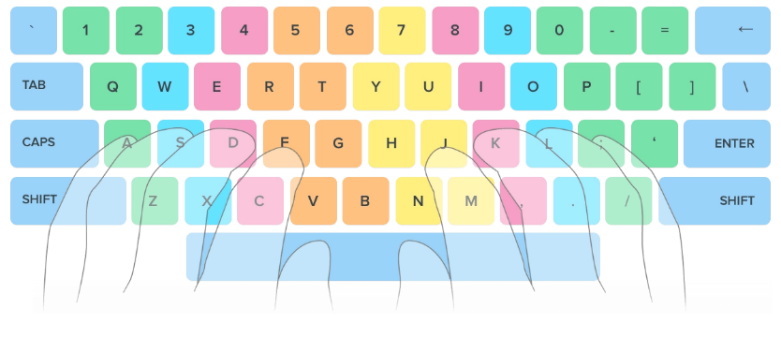
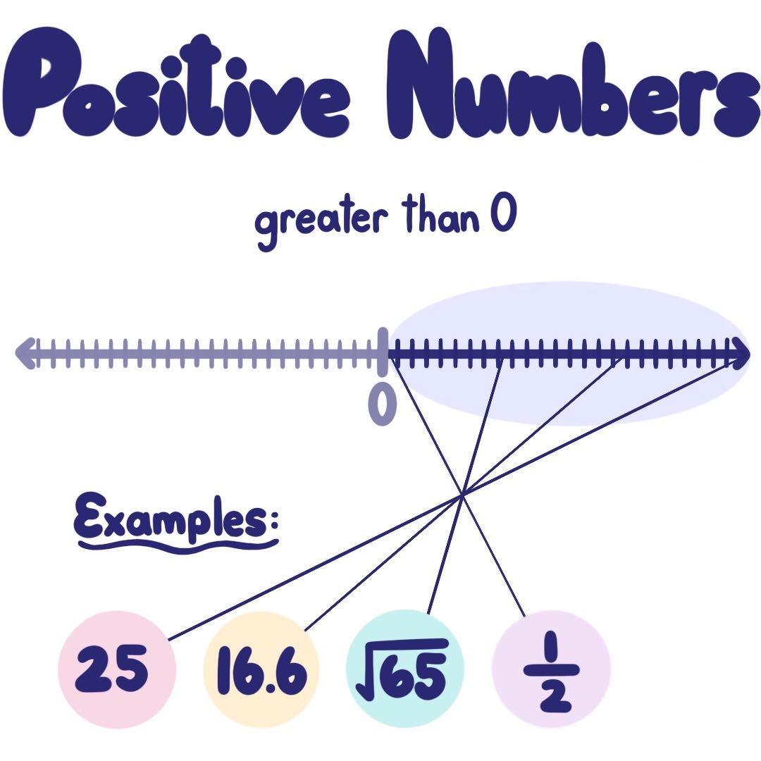
Lets write a sample code (positive number)

Slide 11









Lets write a sample code (browser vendor)

Slide 12
Control Statements
Keywords & Lower case
Control
Iteration
for
for .. each
while
do while

Slide 13
for Loop
for Loop (Fixed Iterations)
The for loop runs a specific number of times.
It has three parts:
Initialization → let i = 0 (Starting point)
Condition → i < 5 (Loop runs while i is less than 5)
Increment/Update → i++ (Increase i by 1 each time)
Example: Print numbers from 1 to 5
for (let i = 1; i <= 5; i++) {
console.log(i);
}
// Output: 1 2 3 4 5
✅ Use for when you know exactly how many times you want to loop.

Slide 14
forEach Loop
forEach Loop (Array Looping)
forEach() is used for iterating over arrays.
It executes a function for each element in the array.
Example: Print each fruit in an array
let automationTools = [“Playwright”, “Selenium", “Puppeteer"];
automationTools.forEach(function (automation) {
console.log(automation);
});
// Output:
// Playwright
// Selenium
// Puppeteer
✅ Use forEach for looping through arrays.

Slide 15
while Loop
while Loop (Condition-Based)
Runs as long as the condition is true.
Useful when we don’t know how many times the loop should run.
Example: Count from 1 to 5
let count = 1;
while (count <= 5) {
console.log(count);
count++; // Increment count
}
// Output: 1 2 3 4 5
✅ Use while when the number of iterations is unknown.

Slide 16
do..while Loop
do...while Loop (Runs at least once)
Runs at least once, even if the condition is false.
The condition is checked after the loop executes.
Example: Run once even if condition is false
let num = 10;
do {
console.log(num);
num++;
} while (num <= 5); // Condition is false (10 is not ≤ 5)
Output: 10
✅ Use do...while when you want the loop to run at least once.

Slide 17
Lets write a sample code (print numbers 1 … 10)

Slide 18
Operators
Arithmetic Operators.
Assignment Operators.
Comparison Operators.
Equality Operators.
Logical Operators.
Ternary (Conditional) Operator (?:).
Optional Chaining Operator (?.) .

Slide 19
Arithmetic Operators
Operator | Name | Example | Result
+ | Addition | 10 + 5 | 15
- | Subtraction | 10 - 5 | 5
* | Multiplication | 10 * 5 | 50
/ | Division | 10 / 5 | 2
% | Modulus | 10 % 5 | 0
** | Exponentiation | 2 ** 3 | 8
++ | Increment | let x = 5; x++ | 6
-- | Decrement | let y = 5; y-- | 4

Slide 20
Assignment Operators
Operator | Name | Example | Equivalent To
= | Assign | x = 10 | x = 10
+= | Add and assign | x += 5 | x = x + 5
-= | Subtract and assign | x -= 3 | x = x - 3
*= | Multiply and assign | x *= 2 | x = x * 2
/= | Divide and assign | x /= 2 | x = x / 2
%= | Modulus and assign | x %= 2 | x = x % 2
**= | Exponentiation and assign | x **= 3 | x = x ** 3

Slide 21
Comparison Operators
Operator | Name | Example |  | Result
== | Equal to (loose equality) | 5 == '5' |  | true
=== | Strict equal (type + value) | 5 === '5' |  | false
!= | Not equal | 5 != '5' |  | false
!== | Strict not equal | 5 !== '5' |  | true
> | Greater than | 10 > 5 |  | true
< | Less than | 10 < 5 |  | false
>= | Greater than or equal to | 10 >= 10 |  | true
<= | Less than or equal to | 10 <= 5 |  | false

Slide 22
Equality Operator
== (Equality Operator - Loose Comparison)
Checks only values, not data types.
Converts (coerces) values to the same type before comparing.
Example:
console.log(5 == "5"); // Output: true
Why?
"5" (string) is automatically converted to 5 (number).v
Since 5 == 5, the result is true.
✅ Use == when you want JavaScript to convert types automatically.
Operands | What JavaScript Does
Boolean == Any | Convert Boolean to Number (true → 1)
String == Number | Convert String to Number ("5" → 5)

Slide 23
Strict Equality Operators
=== (Strict Equality - Strong Comparison)
Checks both values and data types (No type conversion).
If the types don't match, it returns false immediately.
Example:
console.log(5 === "5"); // Output: false
Why?
5 is a number, "5" is a string.
Since the types are different, the result is false.
✅ Use === when you want to compare values without type conversion.

Slide 24
Inequality Operator
!= (Inequality - Loose Comparison)
Checks if values are different (ignores data type).
Converts (coerces) values to the same type before comparing.
Example:
console.log(5 != "5"); // Output: false
Why?
"5" (string) is converted to 5 (number).
Since 5 == 5 is true, 5 != "5" is false.
✅ Use != when you want to check for inequality but allow type conversion.

Slide 25
Strict Inequality Operators
!== (Strict Inequality - Strong Comparison)
Checks both value and data type (No type conversion).
If types are different, returns true immediately.
Example:
console.log(5 !== "5"); // Output: true
Why?
5 (number) is not the same type as "5" (string).
Since types are different, it returns true.
✅ Use !== when you want to check inequality without type conversion.

Slide 26
Logical Operators
Operator | Name | Example | Result
&& | Logical AND | true && false | false
|| | Logical OR | true || false | true
! | Logical NOT | !true | false
&& - Logical AND
||- Logical OR
let age = 25;
if (age > 18 && age < 60) {
console.log("You are eligible to work.");
}
let isWeekend = true;
let isHoliday = false;
if (isWeekend || isHoliday) {
console.log("You can relax today!");
}
! – Logical NOT
let isLoggedIn = false;
if (!isLoggedIn) {
console.log("Please log in to continue.");
}

Slide 27
Ternary(Conditional) Operators
Operator | Name | Example | Result
? : | Ternary Operator | 10 > 5 ? "Yes" : "No" | "Yes"
What is it?
The ternary operator is a shorthand for writing an if-else condition in a single line. [Refer config file for real time understanding]
Syntax:
condition ? value_if_true : value_if_false;
If the condition is true, it returns value_if_true.
If the condition is false, it returns value_if_false.
Example:
let age = 18;
let message = age >= 18 ? "You can vote!" : "You cannot vote.";
console.log(message); // Output: "You can vote!"
Equivalent using if-else:
let age = 18;
let message;
if (age >= 18) {
message = "You can vote!";
} else {
message = "You cannot vote.";
}
console.log(message);
✅ Ternary operator is useful when you want to write simple conditions in a short way.

Slide 28
Optional Chaining Operator (?.)
Operator | Name | Example | Result
?. | Optional Chaining | obj?.property | undefined (if obj is null)
Optional Chaining Operator (?.)
What is it?
The ?. operator helps safely access properties of an object without causing an error if the property doesn't exist. [Refer frames concept for real time understanding.]
Syntax: object?.property;
If object exists, return object.property.
If object is null or undefined, return undefined instead of throwing an error.
Example 1: Without Optional Chaining (Error)
let user = null;
console.log(user.name); // ❌ TypeError: Cannot read properties of null
Example 2: With Optional Chaining (Safe)
let user = null;
console.log(user?.name); // ✅ Output: undefined (No error)
let user = { name: “Ravi"};
console.log(user.name); // Output: “Ravi"

Slide 29
Summary
3 types of control statements: Selection, Iteration and Jump
Selection: if – else vs switch – case (performance oriented)
Iteration : for (count based) vs while (condition based)
Jump : break (out of iteration), continue (skip iteration)
Operators: Different operators used in JavaScript.

Slide 30
Classroom Exercise (Breakout)
Write a program to print only odd numbers between 1 to 20
Before writing the code – follow the 3 step process:
Understand the problem
Solve the problem (Using Pseudocode)
Write the code

